Slide 1

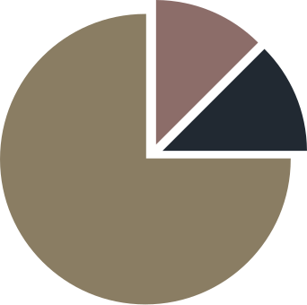
USA
HOUSING MARKET ANALYSIS
YOGESH PATIL
2023

Slide 2

Important Links
Tools Used
INDEX
Approach and Process
Top Identified Rating Factors
Report Coverage
Insights
Recommendations
Challenges and Solutions
Considerations
Data Sources
Reference and Helping Links

Slide 3



TECHNICAL ANALYSIS
IMPORTANT LINKS
US Housing Analysis 2003-2023
Please follow links for better understanding
DASHBOARD
US Housing Market Dashboard

Slide 4
TOOLS USED
TECHNICAL ANALYSIS
PYTHON (MATPLOTLIB, SEABORN, PANDA, NUMPY, PLOTLY)
DASHBOARD
TABLEAU

Slide 5

APPROACH AND PROCESS
TECHNICAL ANALYSIS
KEY MODELS
VISUALIZATION
Utilized Python for technical analysis and visualization.
Linear Regression, Random Forest, Gradient Boosting.
Tableau for dashboard visualization.

Slide 6


BEST DATA MODEL
Linear Regression
Linear Regression demonstrated superior performance with a Mean Squared Error of 83.58.

Slide 7
TOP IDENTIFIED RATING FACTORS
Factors that affect the Housing Price Index based on co-relation
Median Household Income
Urban Population
5/5
4/5
MEHOINUSA646N
Urban Population
Total Construction Spending
Total Housing Units
5/5
4/5
TLRESCONS
ETOTALUSQ176N
Median Sales Price of Houses Sold
GDP Per Capita
5/5
4/5
GDP Per Capita
MEHOINUSA646N

Slide 8
INSIGHTS
POSITIVE CORRELATIONS
Strong positive correlations between economic indicators and the Home Price Index.
Median Household Income, Total Construction Spending, Median Sales Price of Houses Sold, Urban Population, GDP Per Capita, Total Housing Units.
NEGATIVE CORRELATIONS
Negative correlations between economic indicators and the Home Price Index.
30-Year Fixed Rate Mortgage Average (MORTGAGE30US), 15-Year Fixed Rate Mortgage Average (MORTGAGE15US)

Slide 9
RECOMMENDATIONS
Focus on Economic Growth: Prioritize initiatives fostering economic development for a healthy housing market. | Affordability Measures: Monitor and address factors influencing interest rates for increased homebuyer demand.
Income and Housing Affordability: Support income growth and affordable housing initiatives. | Market Monitoring: Balance housing supply and demand to avoid price bubbles.
Risk Management in Mortgage Rates: Acknowledge weak negative correlations and implement risk management strategies. | Construction and Housing Supply: Prioritize initi﻿atives fostering economic development for a healthy housing market.

Slide 10

CHALLENGES
SOLUTIONS
ADDRESSING POTENTIAL SHIFTS IN THE HOUSING MARKET DUE TO ECONOMIC FLUCTUATIONS.
IMPLEMENT PROACTIVE MONITORING AND ADJUSTMENT STRATEGIES BASED ON ECONOMIC INDICATORS AND KEY FACTORS.

Slide 11

CONSIDERATIONS
Observed correlations with mortgage rates (weak negative), requiring attention to potential interest rate changes.
Emphasized the importance of monitoring median sales prices, construction spending, and employment levels for early-warning signals.

Slide 12


DATA SOURCES
Federal Reserve Economic Data (FRED)
International Monetary Fund (IMF) Data

Slide 13
REFERENCE AND HELPING LINKS
Home LLC Housing Market Insights
J.P. Morgan Real Estate Insights
Impact of Interest Rates on House Prices
Congressional Research Service (CRS) Report
Investopedia: How Does Law of Supply and Demand Affect Housing Market

Slide 14
THANK
YOU

